Slide 1
Go Abroad Informative Event
November
2023

Slide 2
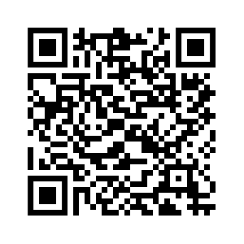
International Office website

Slide 3
Timetable
The event will last approximately two hours
15-20 minutes about motivation and choice
30-35 minutes all around the application
5-10 minutes summer schools and internship
15 minutes break
45 minutes discussion and questions

Slide 4
Agenda
Identifying the right destination
Financing your stay abroad
Eligibility Criteria
Application process
Selection Process
Credits transfer
Summer Schools
Internships

Slide 5
Abroad opportunities while studying at the HU:
Studying abroad
Summer courses
Internship
… combination of all of the above!
Time abroad is not only a unique experience but could also turn into a game changer
Notes:
Die Humboldt-Universität gehört zu den bedeutendsten Hochschulen im deutschsprachigen Raum. Ihre Wissenschaftler:innen zählen zu den führenden Köpfen ihrer Disziplinen.
Spitzenforschung à la Humboldt schließt ausdrücklich den wissenschaftlichen Nachwuchs ein, der frühzeitig Möglichkeiten zur eigenständigen Arbeit in Forschung und Lehre erhält. Die Humboldt-Universität ist ein Ort, an dem junge Menschen selbstverantwortlich, wissenschaftlich und forschend lernen, sich fachlich und beruflich qualifizieren und zugleich ihre Persönlichkeit bilden, gleichberechtigt und im Austausch mit Forschenden und Studierenden weltweit.

Slide 6
Narrowing down the search by asking
yourself the right questions
How do I benefit most from studying abroad?
What do I want to achieve during my time abroad?
Is the course offer any differnt?
Are there any different specialisations?
In what language do I want to study?
Mind the different academic calendars and turn it to your advantage
Use the network of your host university
Checklist
Reports from former outgoing students

Slide 7
Mind the restrictions
Some partnerships are open to Bachelor or Master students only
Focus on Business or Economics: all students are entitled to apply BUT students applying for the right focus will have higher ranking
Some destinations are only available during the fall semester
In rare cases you could follow courses outside the fields of Business and Economics
Bachelor students are usually not permitted to take Master courses and vice versa
Language restrictions
Where to see the restrictions: bear with me

Slide 8
Different type of exchange institutions
Partners affiliated with the university
Central International Office (Unter den Linden 6)
exchange@hu-berlin.de
Erasmus worldwide
Central International Office (Unter den Linden 6) –
erasmus.international@hu-berlin.de
Partners affiliated with the faculty
Faculty International Office (Spandauer Straße 1)
Erasmus+ Partners
Faculty International Office (Spandauer Straße 1)
Notes:
North Macedonia
Serbia
Iceland
Liechtenstein
Norway
Türkiye

Slide 9
Our Partners: facts and figures
> 80
Partners worldwide
>200
Spots per academic year
28 Countries
Majority in Europe
~ 110 Applications
Business Administration or Economics

Slide 10
Finance your study abroad
Erasmus scholarship (between 490 – 600€ per month)
Swiss mobility scholarship
Auslands-Bafög
WWG-Stipendium (Business and Economics Society Scholarship)
PROMOS (promos.international@hu-berlin.de)
FAQ on our website
Keep in mind: Save some money before your trip!

Slide 11
Erasmus Grant
Country Group A | Country Group B | Country Group C
Denmark, Finland, Ireland, Iceland, Lichtenstein, Luxembourg, Norway, Sweden | Austria, Belgium, Cyprus, Greece, Spain, France, Italy, Malta, the Netherlands, Portugal | Bulgaria, Czechia , Estonia, Croatia, , Hungary, Lithuania, Latvia, Poland, Romania, Slovenia, Slovakia, Turkey, North Macedonia
600 €/per month | 540 €/per month | 490 €/per month
Study duration | Maximum grant
1 term | 3 months = 90 days
2 terms | 5,5 months = 165 days
1 semester | 4,5 months = 135 days
3 terms | 8,5 months = 255 days
2 semesters | 8,5 months = 255 days

Slide 12
Finance your study abroad
Erasmus scholarship (between 490 – 600€ per month)
Swiss mobility scholarship
Auslands-Bafög
WWG-Stipendium (Business and Economics Society Scholarship)
PROMOS (promos.international@hu-berlin.de)
FAQ on our website
Keep in mind: Save some money before your trip!

Slide 13
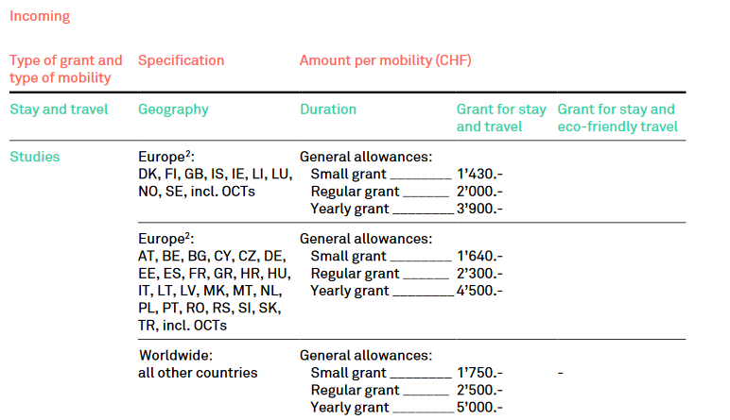
Swiss mobility Grant
Sourcehttps://www.movetia.ch/programme/international/schweizer-programm-zu-erasmus/hochschulbildung-und-hoehere-berufsbildung/mobilitaet
Notes:
Duration between a minimum of 60 days and 3 months: small grant, usually applicable to one
term
- Duration between 3 months + 1 day and 7 months: regular grant, usually applicable to 1
semester or 2 terms
- Duration between 7 months + 1 day and 12 months: yearly grant, usually applicable to 2
semesters or 3 terms

Slide 14
Finance your study abroad
Erasmus scholarship (between 490 – 600€ per month)
Swiss mobility scholarship
Auslands-Bafög
WWG-Stipendium (Business and Economics Society Scholarship)
PROMOS (promos.international@hu-berlin.de)
FAQ on our website
Keep in mind: Save some money before your trip!

Slide 15
Eligibility Criteria
Overall grade: 1 – 2,9
Proof of Enrollment at HU
Bachelor students can start applying in your 3rd semester
Bachelor students must have min. 30 credits (official transcript)
Master students can start applying in your 1st semester
Master students´ evaluation is based on Bachelor-Diploma
Language proficiency: English B2 / C1 and local language (if applicable)
Strong motivation (no separate letter of Motivation)
Submit your application on time

Slide 16
The application process
One single application for all exchange programs: Erasmus / SwissMobility / Faculty wide agreements (beyond Erasmus & Switzerland)
Application period: 1st of November – 15th of December 2023
Application deadline: 15th of December 2023
Exchange period: Academic Year 2024-25 (fall semester 2024-25 and / or spring semester 2025)
Online application portal: „Moveon“
3 destinations / choices (regardless of the exchange program)

Slide 17
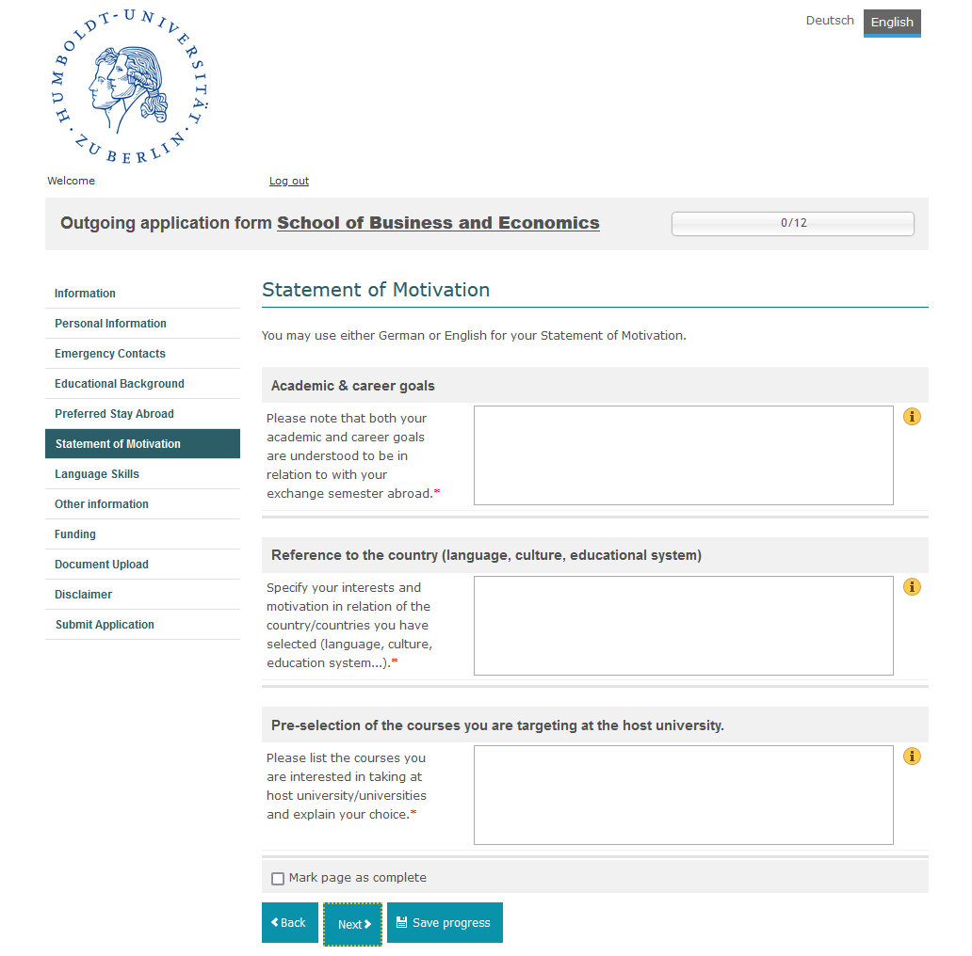
Motivation
Notes:
Max 200 words

Slide 18
The selection process
Ranking system
Maximum score 220
Points distribution:
Academic performance: 0 - 120 points
Motivation: 0 - 50 points
Language skills - English: 12 - 25 points
Language skills – Local language (optional): 0 - 25 points
Placements are assigned based on the quality of your application and the number of applications received for the relevant destination

Slide 19
Selection process timeline
What | When
01.11.2023-15.12.2023 | Application window
January 2024 | Int. Off. Will assses the application and rank them
1st week of Febraury 2024 | Applicants whose 1st choice can be granted will be notified – 1 week time to accept or decline
3rd week of February 2024 | Applicants whose 2nd choice can be granted will be notified – 1 week time to accept or decline
1st week of March 2024 | Applicants whose 3rd choice can be granted will be notified – 1 week time to accept or decline
End of March 2024 | Nominations submission at host institutions
April/May 2024 | Instructions from host institutions directly to nominees
April/May 2024 | Second round of application for those who did not get any placement
June 2024 | Erasmus+ Student will receive and sign their grant agreement
Notes:
Max 200 words

Slide 20
Credits transfer
The Examination Office is responsible for it
You need to achieve at least 24 credits
It is up to you how many credits you wish to transfer
Observe the rules and regulations of your own study program
You could mange to transfer 24-30 credits for one semester

Slide 21
Apply for a summer school
Tuition waiver
- The Undergraduate Summer School at King's College London (Bachelor)
- Other programmes will be added soon on our website
Notes:
Motivation letter (1-2 pages max)
- Current transcript of Records (certified by the Examination Office)
- You need to have achieved 30 credits min in either (not each of of them) of the following subjects: Business/Economics/Management/Statistics
- Proof of English proficiency at C1 level
- Copy of your student´s ID
Email an outgoings-wiwi@hu-berlin.de – Deadline 31.01.2024

Slide 22
Go for an internship abroad
Erasmus+ Internship
Application through the central International Office (Unter den Linden 6)
There is no institution list – you can always enquire at the central International Office
Depending on your study program you could earn credits for it
DAAD fundings
Internship programs with AIESEC
Notes:
Prerequisites
The following requirements currently apply for Erasmus+ internship funding:
Students:
Must be enrolled at the HU or Charité
Must have a private address in DE (not in the target country)
Must have (at least) B2 language skills in the working language (a language certificate is not required if the working language is the native language)
Internship:
Must be related to the content of the degree programme
Must be completed full-time (at least 35 hours/week - teaching degree: at least 12 hours/week)
Must be completed in full with "enrolled" or "exmatriculated" status (status may not change during an internship)
Must take place in one of the participating programme countries
Internship duration:
Minimum of 2 months (60 "Erasmus days", according to the EU calculator)
Maximum of 12 months (360 days)
Sufficient Erasmus+ "remaining contingent" (12 months for semesters abroad and/or internships abroad per study phase BA, MA, PhD - 24 months for state examinations)
Graduate internship:
Possible for up to 12 months after academic graduation
Application must be made in advance with "enrolled" status

Slide 23
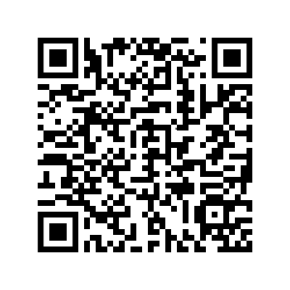
Internship - Central International Office

Slide 24
Q&A

