Slide 1
Exchange semester – next steps academic year 2024/25
International Office, School of Business and Economics

Slide 2
Irene Orrigo
Head international Office outgoings-wiwi@hu-berlin.de
Office hours:
Mo/Tue/Wed 10-12 Thu 15-17
Tel: 030 20 93 99504
Contact

Slide 3
Lots of information
Power point sent to you via email and uploaded on the website
Room for questions
Arrange individual meeting if needed
Presentation
(120 min)

Slide 4
Agenda
Introduction: where do we stand now
Nomination: what is it and current status
Registration/Application: what, how, when
Matriculation at the HU
(Online) Learning Agreement
Grant Agreement/Swiss Mobility

Slide 5
Agenda
Erasmus academic requirements
Transfer of credits
Bachelor and Master thesis
Visa
Health Insurance
How to connect

Slide 6

Where do we stand now?
Over 90 Students going abroad
Winter Semester 2024/25 or Summer Semester 2025 or both
18 Countries
44 universities
Submitted nominations: 62 out of 91
Notes:
Over 90 Stundents going aboad : Erasmus/Faculty/Swiss Mobility

Slide 7



Application at HU
Offer acceptance
Nomination (International office´s task)

Slide 8



Application / Registration at Host University
OLA / GA / Health Insurance / Visa (if needed)
Stay abroad

Slide 9
Nomination
The act of oficially recommendig you as an exchange student to the partner university
This way we ensure that the partner university will trust you are coming from a partner institution and you are fulfilling the requirements. Nevertheless you will still need to register / apply again at the partner university directly.
The Nomination becomes a requirement itself

Slide 10
Nominated
The REST
Not nominated yet
University of Copenhagen
Université Paris-Dauphine
Neoma Business School
Bocconi Mailand
University of Oslo
Wirtschaftuniversität Wien
ISCTE Business School
Universität St. Gallen
Universitat de Barcelona
Universidad Carlos III de Madrid
Universidad de Malaga
Nominations: current state

Slide 11
Application / Registration at host university
What: before registering/enrolling at the host university you might be required to apply
How: the host university will get/has got in touch with you clearly indicating how to apply and register and what documents are required
When: for some of you it has already happened, for some other it will happen from the next days until the beginning of April approximately
Notes:
Understand the application process and meet the deadline
Your host university will contact you
Proactively inform the incoming team of your host institution in a timely manner if this does not happen (and put us in copy)
Exchange students for the Summer semester 2025 might be contacted a bit later
Your host institution will instruct you how to:
Enroll as a exchange Student
Register for courses
Apply for accommodation (if applicable)
Important: you may be required to submit a motivation statement and an additional proof of language proficiency.
However unlikely, your host institution may reject your nomination / application, especially if you do not complete administrative formalities in time or meet the language requirements.

Slide 12
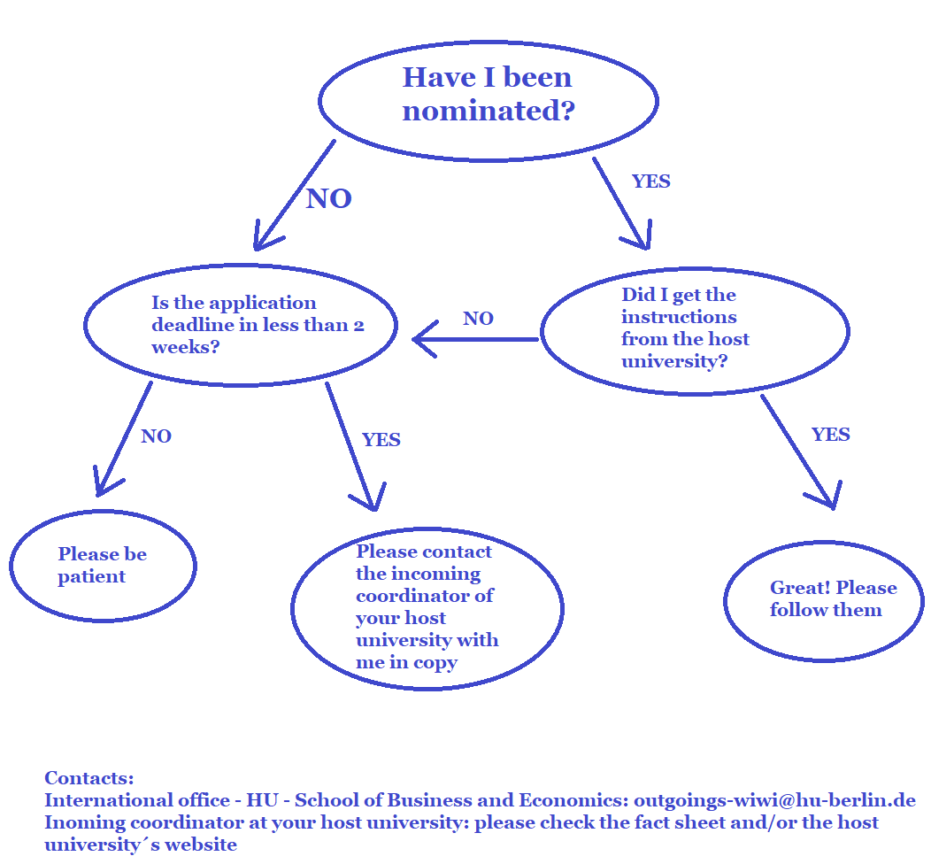

Slide 13
Before going abroad: Matriculation at HU
Enrol as a student at HU as usual („Immatrikulation“)
Gap semester („Urlaubssemester“) is a choice
Gap semester:
registered as a student
you can register for exams
the semester spent abroad is not considered as a „Fachsemester“
only administrative fees an no „Semesterticket“
Gap semester: up to six weeks after the start of the semester
No tuition fees at the host institution
Possibly “Semesterticket” and/or admin fees at host institution

Slide 14
Before going abroad: Learning Agreement
When: before the beginning of the lectures at the host university
Where: on our website either form or instructions for OLA
What: list of courses you have selected
Why: facilitation of transfer of credits and guarantee of grant for Swiss Mobility and Erasmus
Not optional

Slide 15
Before going abroad: Learning Agreement
Signed by: you, me and incoming coordinator at your host univeristy
Who is responsible for it: you
Swiss Universities might provide you with their own template
Erasmus participants: Learning Agreement ≠ Grant Agreement
Changes are allowed

Slide 16
Before going abroad: Learning Agreement
Erasmus participants: use OLA = Online Learning Agreement
Instructions on our webpage
Some of our partner institutions do not use OLA yet
If your OLA gets rejected: go through the process again and re-submit
2 Semesters = 2 separate Learning Agreements

Slide 17
Erasmus Grant Agreement/Swiss Mobility
What: binding contract to receive the grant
When will you get it: at latest in May
When do you need to submit it: at the latest in June
How: via email from us, it needs to be sent hand signed and returned per post to us (via mail or per hand in the office or in the postbox number 26)

Slide 18
Erasmus/Swiss Mobility requirements
No pain no gain: how to make sure you will get the € € €
2 instalments: 1st 2/3 of the amount, after arrival
2nd 1/3 after return
How to get the 1st : - Grant Agreement/Swiss Mobility Agreement
- OLS Language test (Erasmus only)
- OLA (or form per E-Mail)
- Confirmation of registration

Slide 19
Erasmus/Swiss Mobility requirements
No pain no gain: how to make sure you will get the € € €
How to get the 2nd : - right before leaving: Confirmation of stay abroad
- EU online Survey (Erasmus only)
- Alumni report (“Erfahrungsbericht”)
- Transcript of records
- Credit transfer form

Slide 20
Erasmus/Swiss Mobility academic requirements
No pain no gain: how to make sure you will not be asked the € € € back
ECTS : 24 semester / 15 trimester
All 24 ECTS credits are to be displayed in your transcript of records from your host institution
Erasmus academic requirements ≠ transfer of credits
Aim 30 ECTS to make 24 sure
(Hardship case)

Slide 21
Transfer of Credits
Regulation in study program: it states what abroad courses can be recognised
Courses beyond this group need to be validated as „equivalent“
Validation as equivalent: the course coordinator at HU needs to give his / her approval. Keep a written trace of it. Ask them at the beginning of the semester rahter than at the end
Go for the electives instead of the core / compulsory courses
Interdisciplinary courses are easy to get credits for

Slide 22
Transfer of Credits
You can choose how many courses and whether you want to transfer credits at all
The examination office is responsible for the transfer of credits
Courses taken abroad can be retaken at the HU as long as you have not transferred the credits

Slide 23
Bachelor and Master Thesis
Only HU professors allowed to supervise and grade thesis
No credits for thesis within framework of exchange Semester
Academic research for thesis allowed during exchange semester

Slide 24
Visa
EU+Schengen Area → EU+Schengen Area = no need
EU+Schengen Area → non EU+Schengen Area = need
non EU+Schengen Area → EU+Schengen Area = double check
Golden rule: check with embassy even before getting letter of admission from host university

Slide 25
Health insurance
EU citizens + EU Country = coverage extension
Coverage extension = (partial) coverage of medical bills and emergencies
Depending on Country: you may need to pay for medical bills and request a reimbursement
Non EU citizens: contact health insurance – possibly purchase coverage extension
Non EU countries: contact health insurance – possibly purchase coverage extension

Slide 26
How to connect
Moodle Chatroom (ERASMUS Outgoings WiWi - Diskussionsforum und Tauschbörse)
Alumni reports (students from the previous years)
Social networks at host institution
Buddy/mentoring programs at host institution
Volounteer to create/manage group

Slide 27
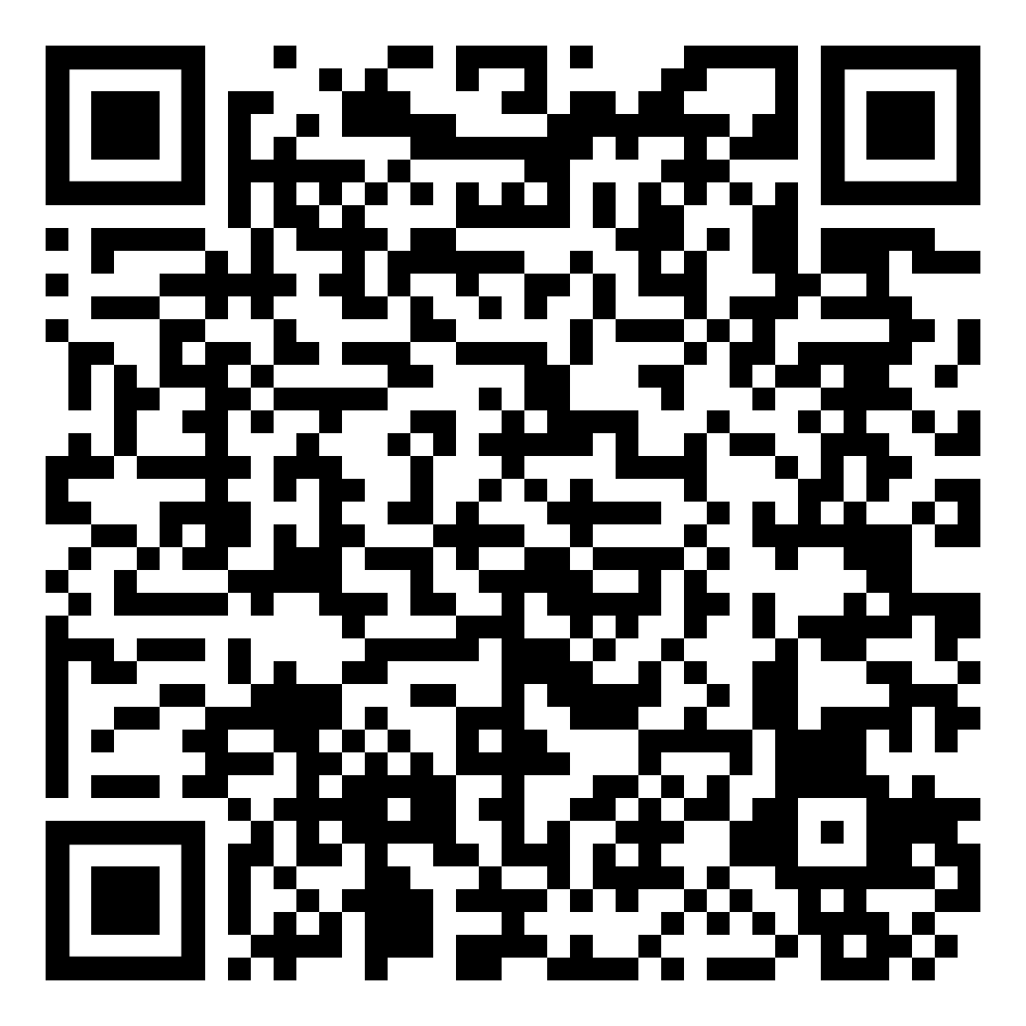
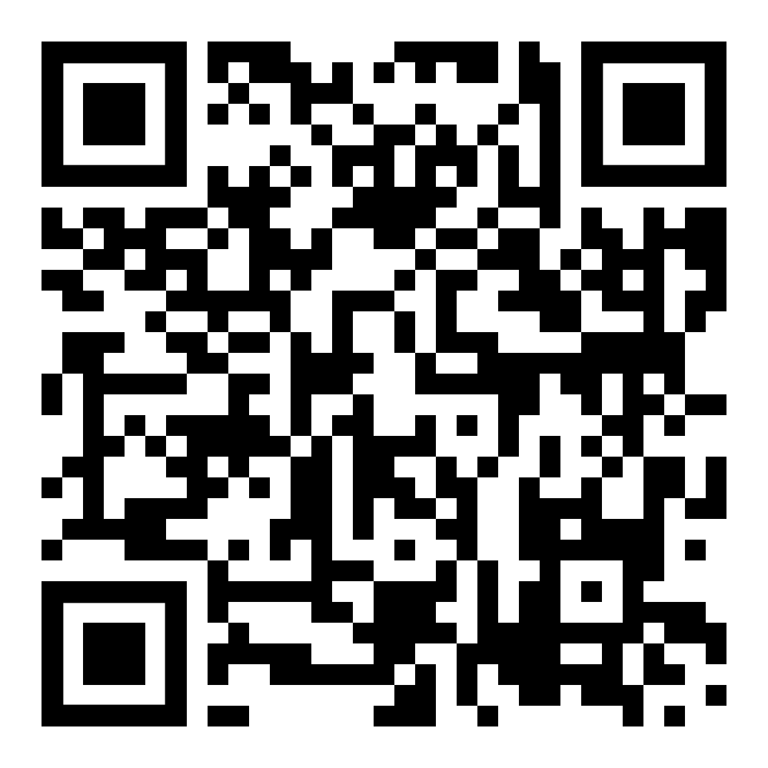
Useful links
Our website: timeline and forms
Examination office:
study regulation

Slide 28

Questions

